Slide 1

Modelling Impact of Non-Standard Conditions
Axel Albers
Deutsche WindGuard Consulting GmbH, Varel, Germany
(a.albers@windguard.de)

Slide 2
Content
Modelling of effect of environmental conditions on power curves according to the draft revision of IEC 61400-12-1, Ed.2
Implications on power curve warranties and wind resource assessments

Slide 3
Status of Revision of IEC 61400-12-1
Includes methods for taking care of wind shear, wind veer and turbulence effects on power curves
Committee Draft (CD) Edition 2 available since September 2011
Integration of national comments completed
Committee Draft for Voting (CDV) expected at end of 2012
Final revision expected in 2013
Release of standard expected in 2014

Slide 4
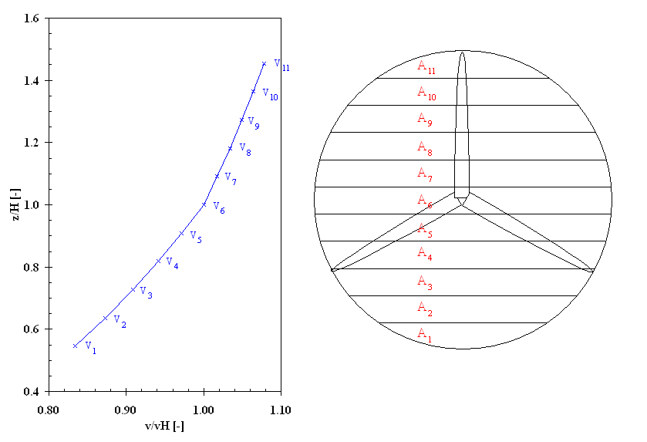
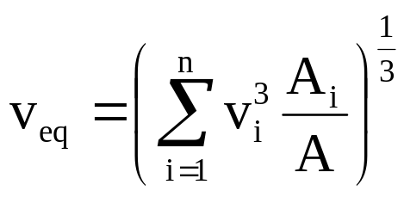
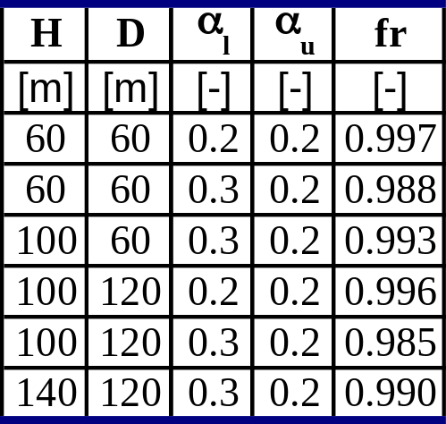
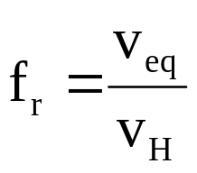
Rotor Equivalent Wind Speed: for Taking Into Account Wind Shear Effects
Wind shear effect is described by Shear Correction Factor:

Slide 5
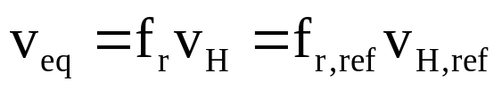
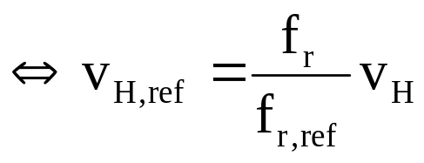
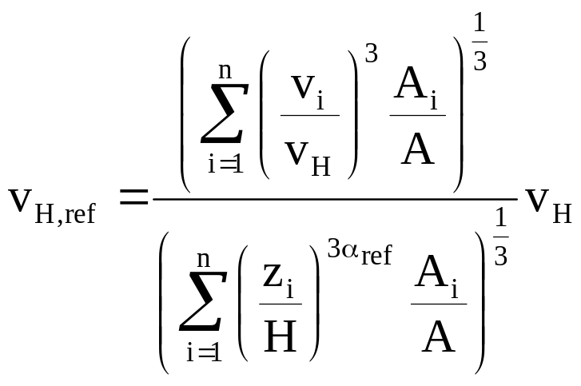
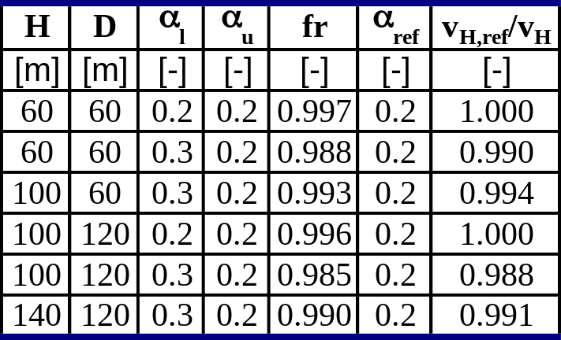
Wind Shear Normalisation: to Get a Hub Height Wind Speed Power Curve for Defined Wind Shear Conditions
The same v_{eq} can be reached by different combinations of f_{r}’s ans v_{H}’s:
If reference profile is a power law:

Slide 6
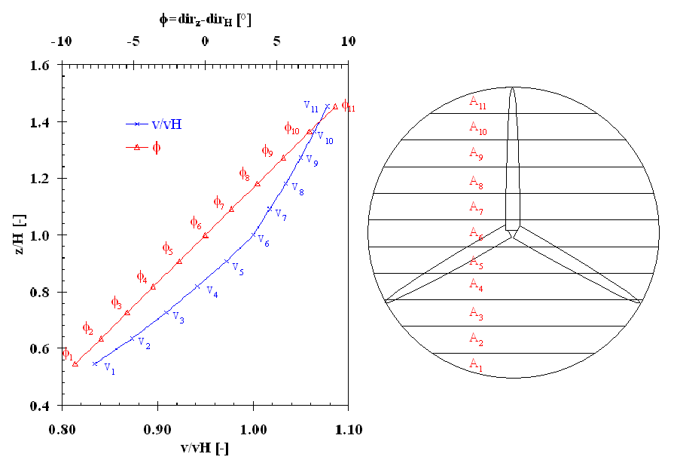
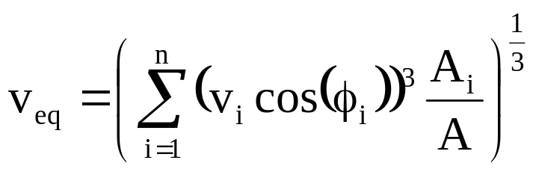
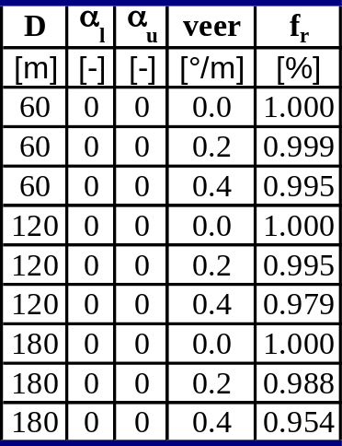
Extended Rotor Equivalent Wind Speed: for Taking Into Account Wind Shear and Wind Veer Effects
Combined shear and veer effect is described by:
Normalisation to reference shear and veer conditions possible as in case of just normalising shear effects

Slide 7
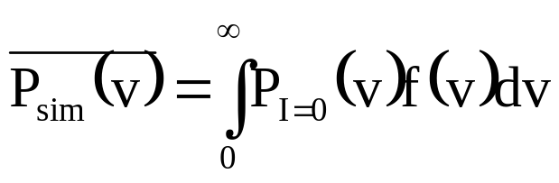

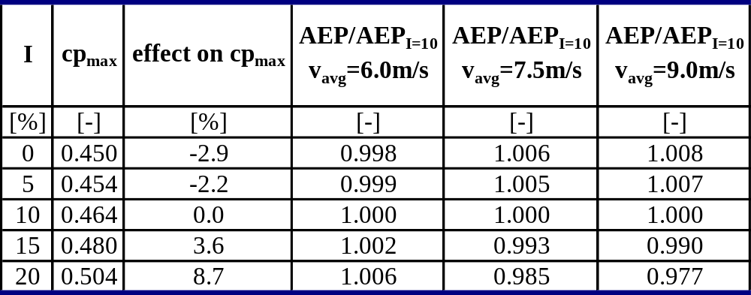
Turbulence Normalisation
Only the effect of data averaging over 10-minute period is considered
Key assumption: turbine output follows instantaneous changes of wind speed, i.e. turbine always follows a certain power curve P_{I=0}.
mean power output over 10 minutes:
f(v): wind speed distribution measured over 10 minutes
Zero turbulence power curve P_{I=0} is determined from measured power curve under consideration of measured turbulence intensity
Turbulence Normalisation:
Example:
WT with 382 W/m²

Slide 8
Treatment of Uncertainties
Uncertainty of all corrections is taken into account:
- air density correction
- wind shear correction
- wind veer correction
- turbulence correction
Only the air density correction is obligatory, but:
Added uncertainty if no correction according to
- wind shear
- wind veer
- turbulence intensity

Slide 9
Conflict WT Owner, WT Supplier
Owner wants site specific power curve for his economic considerations
Supplier has problems to warrant site specific power curve:
- site conditions often not well known
- supplier cannot be hold liable for possible special atmospheric
conditions at power curve verification (takes only 1 to 6 months)
- warranty on site specific power curve more difficult to manage than
generic power curve

Slide 10
Conflict WT Owner, WT Supplier
Owner wants site specific power curve for his economic considerations
Supplier has problems to warrant site specific power curve:
- site conditions often not well known
- supplier cannot be hold liable for possible special atmospheric
conditions at power curve verification (takes only 1 to 6 months)
- warranty on site specific power curve more difficult to manage than
generic power curve

Slide 11
Current Situation
Economics, Wind Resource Assessment
PC Warranty
PC Verification
Generic PC, often valid only for idealised conditions
Owner uses generic PC for economic calculations;
yield expectations often too high!
Often neither owner, nor sales people from suppliers, nor wind resource experts are aware of the problem
special filtering:
sometimes long extension of verification

Slide 12
Immediate Improvement
Economics, Wind Resource Assessment
PC Warranty
PC Verification
Generic PC, often valid only for idealised conditions
PC adjusted to mean site conditions by methods of IEC 61400-12-1, Ed. 2
Add uncertainties of corrections according to IEC 61400-12-1, Ed. 2 (can be high)
Minimum: use generic PC and add uncertainties for not correcting PC to site conditions (can be high)
special filtering:
sometimes long extension of verification

Slide 13
Future Improvement, Generic PC
Economics, Wind Resource Assessment
PC Warranty
PC Verification
Generic PC
Based on equivalent wind speed
Alternative: valid for reference shear and veer profiles
Valid for reference turbulence
Valid for reference air density
Use equivalent wind speed
or adjust PC to mean shear and veer conditions by methods of IEC 61400-12-1, Ed. 2
Adjust PC to mean turbulence and air density conditions by methods of IEC 61400-12-1, Ed. 2
Add uncertainties of corrections according to IEC 61400-12-1, Ed. 2 (can be high)
Use equivalent wind speed
or adjust PC to reference shear and veer conditions by methods of IEC 61400-12-1, Ed. 2
Adjust PC to reference turbulence and air density conditions by methods of IEC 61400-12-1, Ed. 2
Add uncertainties of corrections according to IEC 61400-12-1, Ed. 2 (can be high)

Slide 14
Future Improvement, Site Specific PC
Economics, Wind Resource Assessment
PC Warranty
PC Verification
PC specific for mean site conditions
Take PC as it is
Assess added uncertainty due to distribution of wind shear, wind veer, turbulence and air density conditions in analogy to IEC 61400-12-1, Ed. 2
Use equivalent wind speed
or adjust PC to mean shear and veer conditions by methods of IEC 61400-12-1, Ed. 2
Adjust PC to mean turbulence and air density conditions by methods of IEC 61400-12-1, Ed. 2
Add uncertainties of corrections according to IEC 61400-12-1, Ed. 2

Slide 15
If PC Verification Possible Only Based on Hub Height Measurement
Economics, Wind Resource Assessment
PC Warranty
PC Verification
See previous slides
See previous slides
Adjust PC to mean turbulence and air density conditions by methods of IEC 61400-12-1, Ed. 2
Add uncertainties of turbulence and air density corrections according to IEC 61400-12-1, Ed. 2
Add uncertainty for not correcting PC in terms of wind sheer and veer according to IEC 61400-12-1, Ed. 2 (can be high)

